Slide 1
Introduction to RDD

Slide 2
What is RDD?
RDD stands for Resilient Distributed Datasets
RDD is the primary data abstraction in Apache Spark and core of spark.
As the name suggests RDD is a resilient ( fault – tolerance ) records of the data that resides on multiple nodes.

Slide 3
Advantage of RDD
With RDD the creators of spark managed to hide data partitioning and distribution.
Learning about RDD by its name i.e.
Resilient i.e. Fault Tolerant
Distributed i.e. Distributed across multiple node
Dataset i.e. Collection of partitioned data

Slide 4
Features of RDD
In-Memory i.e. Data inside RDD will be kept in memory as long as possible
Immutable i.e. data cannot be changed means once we create a RDD that will be parent RDD so we can have transformation of RDD but original RDD cannot be changed.
Lazy Evaluated i.e. delaying the computation until it is required.
Parallel i.e. data will be processed in parallel.

Slide 5
RDD operations
RDD supports two type of operations
Transformation
Actions
Transformation is changing the state of the data from one state to another without getting any outputs.
All the transformations are lazily evaluated i.e. they wait for any action to be called so actions act as a triggers. When you call an action you get output.

Slide 6
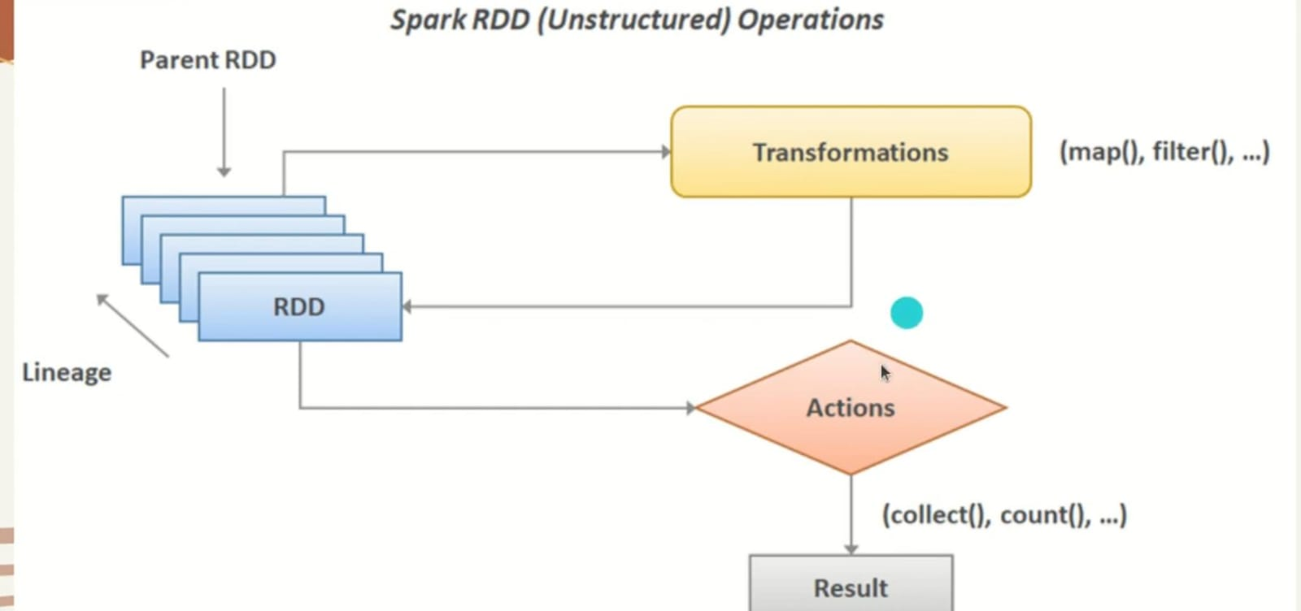

Slide 7
Ways to create RDD in Spark
RDD’s are fundamental data structure of Apache spark. It is the basic abstraction that is being used in Apache Spark.
There are 4 ways to create RDD:
Using sparkContext.parallelize method
Using sparkContext.textFile method
To create a RDD from existing RDD using flatMap
Create a RDD from existing data frame

Slide 8
1. Using sparkContext.parallelize method
To get the collection from the driver program of Scala or python and the apply sparkContext.parallelize method to get the RDD created.
This method is only useful for testing purpose we cannot use this in real-time because entire data is stored in single node which is not recommended in real-time.
val rdd = sc.parallelize(List(10, 20, 30, 40))

Slide 9
Example
val r1 = spark.sparkContext.parallelize(Seq((" A ",1),(" B ",2),(" C ",3)))
This will create a RDD containing string and int values and
type got inferred because of type inference property of Scala.
To print the content on console:
r1.foreach(println)

Slide 10
Notation in spark O/P
Spark uses multiple tasks to process RDDs in parallel.
The notation (0 + 4) / 4 is a progress indicator:
  0: Number of tasks already completed.
  4: Number of tasks running or pending.
  4: Total number of tasks assigned for execution.

Slide 11
2. Using sparkContext.textFile method
We will read an external file to create a RDD in this method.
For this method we need to have a file with some content on our system and path of that file will be provided to create a RDD using existing file.

Slide 12
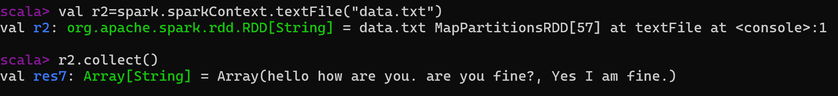
Example
val r2=spark.sparkContext.textFile("data.txt")
r2.collect()
RDD will be created as per the type of data stored in existing file.
Collect is an action here which will print the content of file.

Slide 13
3. Create a RDD from existing RDD using flatMap
Here we will be using r2 RDD created in last example by applying flatMap transformation and it will split down the content of r2 RDD.
Example:
val r3 = r2.flatMap(_.split(" "))
r3.collect()
flatMap is a transformation which is used to read the data word by word.

Slide 14
4. Create a RDD from existing data frame
Here we will be using range instead of data frame to create a RDD.
Example:
val r4 = spark.range(20).toDF().rdd
r4.collect()
toDF() is used to create a data frame out of the range of 20 and
.rdd is used to transform that data frame as an rdd.
If the cluster is not configured properly: forces Spark to run fully local
val df = spark.range(5).toDF("number")
df.show()

Slide 15
This forces Spark to run fully local and avoids the the hostname.
spark.stop()
import org.apache.spark.sql.SparkSession
val spark = SparkSession.builder()
.appName("LocalTest")
.master("local[*]")
.config("spark.driver.host", "127.0.0.1") .config("spark.driver.bindAddress", "127.0.0.1")
.getOrCreate()
scala> :type spark
org.apache.spark.sql.SparkSession // Now you can use spark commands
org.apache.spark.sql.SparkSession.Builder // use .getOrCreate() to exit to ss
spark.range(5).collect().foreach(println)
import org.apache.spark.sql.SparkSession
val spark = SparkSession.builder() .appName("LocalTest") .master("local[*]") .config("spark.driver.host", "127.0.0.1") .config("spark.driver.bindAddress", "127.0.0.1") .getOrCreate()

Slide 16
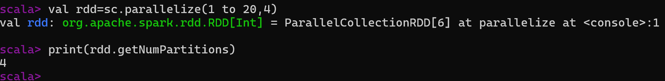
Partitions of RDD
We can create certain partitions of RDD as well.
val rdd=sc.parallelize(1 to 20,4)
Here 4 represents the no. of partitions of an RDD.
To check the created partitions:
print(rdd.getNumPartitions)

Slide 17
To check the specific partitions of RDD we can use glom()
rdd.glom().collect().foreach(println)
This will return us all the 4 partitions in the form of Hashcode (default string representation of JAVA array) in the RDD. To visualize the elements in string form we need to convert that explicitly:
rdd.glom().collect().foreach(arr=>println(arr.mkString(",")))
Here mkString creates a string from the elements of array collection.

Slide 18
Question
Write Scala code to parallelize a simple collection (e.g., an array or list) into an RDD in Spark.
Write Scala code to parallelize a simple collection (e.g., an array or list) into an RDD in Spark.

Slide 19
Solution
// Using array
val data = Array(1, 2, 3, 4, 5)
val rdd = sc.parallelize(data)
rdd.foreach(println)
// Using list
val dataList = List("apple", "banana", "orange", "grape", "pineapple")
val rdd = sc.parallelize(dataList)
rdd.foreach(println)

Slide 20
Question
Provide Scala code to load a text file named "data.txt" into an RDD using the textFile() method in Spark.

Slide 21
Solution
// Load the text file into an RDD
val textRDD = sc.textFile("data.txt")
// Show each line of the file
textRDD.collect().foreach(println)

Slide 22
RDD Transformation
It is a function that produces new RDD from an existing RDD.
There are multiple type of transformation methods which can be used to produce a new RDD.
However, we cannot change the original RDD hence applying the transformation will create RDD lineage.

Slide 23
RDD Transformation Methods
Various methods are there for RDD transformation:
Map()
FlatMap()
Filter()
Union()
Intersection()
Distinct()
groupByKey()
ReduceByKey()
sortByKey()
Join()
Coalesce()

Slide 24
1. map()
Map function iterates over every line of RDD and splits into new RDD.
Function will be applied to every element of RDD.

Slide 25
Example
val flat1 = sc.textFile("data.txt")
val flat2= flat1.map(r=>r.split(" ")) // split the elements
flat2.collect() // print

Slide 26
2. flatMap()
It is similar to map function but the difference is that map return only one element but flatMap returns list of elements.
One common example is creating a RDD from existing RDD by splitting the content into each word.

Slide 27
Example
val flat1 = sc.textFile("data.txt")
val flat3= flat1.flatMap(r=>r.split(" "))
flat3.collect()
map → keeps the nested structure (RDD[Array[String]]).
flatMap → flattens it into a simple sequence (RDD[String]).

Slide 28
3. filter()
Filter() in spark is quite similar to select operator of DBMS i.e. what kind of filtrations we need to perform.
Filter can be used to filter out any specific element from an rdd for example filtering even number from any rdd.

Slide 29
Example:
val x=sc.parallelize( 1 to 10) // create a rdd with 1 to 10 element
x.collect() // print the elements of rdd
val y =x.filter(z=>z%2==0) // filter even numbers
y.collect()

Slide 30
4. Union()
Union() will combine two elements together.
So if we are having two rdd’s it can combine both these rdd’s together.

Slide 31
Example
Lets first create two rdds
val r1=sc.parallelize(Array(1,2,3,4)) // 1st rdd
val r2=sc.parallelize(Array(4,6,7,8)) // 2nd rdd
val un=r1.union(r2) // union
un.foreach(println) // combined result

Slide 32
5. Intersection()
Displays the common part between two rdd’s.
Example:
val r1=sc.parallelize(Array(1,2,3,4))
val r2=sc.parallelize(Array(4,6,7,8))
val i=r1.intersection(r2) // intersection
i.foreach(println) // print common result

Slide 33
6. Distinct()
This function will print the distinct elements only from any rdd.
Duplicate elements will not be printed.

Slide 34
Example
val dup=sc.parallelize(Array(1,2,2,2,2,3,3,3,4,5,6))
val dis=dup.distinct()
dis.foreach(println)
// print distinct elements

Slide 35
7. groupByKey()
This will group the elements of two rdd’s based on the key and value.
Example:
val data=sc.parallelize( Array[(String,Int)] ((‘a’,1),(‘b’,2),(‘c’,3), (‘a’,5),(‘b’,2)),3)
val data=sc.parallelize(Array((‘a’,1),(‘b’,2),(‘c’,3), (‘a’,5),(‘b’,2)),3)
//3 denotes how many partition we need to have in background.
  val group=data.groupByKey()
  group.foreach(println)

Slide 36
8. reduceByKey()
Elements will be reduce with the help of the key in rdd.
For example if we have duplicate elements in any rdd then it can give us that how many times an element is repeating etc.

Slide 37
Example
val words=Array(“one”,”two”,”two”,”three”)
val red=sc.parallelize(words).map(w=>(w,1)).reduceByKey(_+_)
red.foreach(println)

Slide 38
9 sortByKey()
Put the elements in sorted order with respect to the keys.
Example:
val r=sc.parallelize(Seq((“A”,2),(“Y”,4),(“Q”,7),(“F”,6)))
val sorted=r.sortByKey()
sorted.foreach(println)
Elements will be sorted alphabetically.

Slide 39
10 Join()
Joins in SQL are used to join two or more tables.
Similarly here also we will use joins to join two rdd’s.
Example:
  Lets consider two rdd’s first:
  val q= sc.parallelize(Array((‘a’,1),(‘b’,2),(‘c’,3)))
  val p= sc.parallelize(Array((‘a’,4),(‘b’,3),(‘c’,3)))

Slide 40
Join()
Now lets perform join on two rdd’s i.e. p and q.
val v=q.join(p)
v.foreach(println)

Slide 41
11. Coalesce()
Coalesce() is used to reduce number of partitions, itavoid full shuffling of data. So it will reduce the number of partitions.
Example:
  val rdd = sc.parallelize(1 to 100, 6)
  println("Partitions before: " + rdd.getNumPartitions)
  val coalescedRdd = rdd.coalesce(3)
  println("Partitions after: " + coalescedRdd.getNumPartitions)
No difference in output but number of partitions will be reduce to 3.

Slide 42
RDD Operations - Actions
Transformations create RDDs from other RDDs, but when we want to work with the actual dataset, at that point action is performed. When the action is triggered after the result, new RDD is not formed like transformation.
Thus actions are the spark RDD operations that gives non-RDD values.

Slide 43
List of Actions in Spark RDD
Following are the actions that can be performed on the spark RDDs.
1. COUNT | 7. FOREACH
2. COLLECT | 8. TAKESAMPLE
3. TAKE | 9. MAX, MIN, SUM
4. TOP | 10. ISEMPTY
5. COUNTBYVALUE | 11. MEAN, STDEV
6. REDUCE | 12. SORTBY

Slide 44
In order to work with actions we need to create a file with some elements like 1 2 3 4 5 and we need to read that file.
val input=sc.textFile(“C:/Users/Dell/Desktop/rdd.txt”)
All the next actions will be performed on the above rdd.

Slide 45
1. Count
In SQL we use count in order to calculate the number of rows in a table.
It will count the number of values available in the rdd.
Example:
val v1=input.flatMap(_.split(“ “)).count()
This will return us the number of elements in rdd.

Slide 46
2. Collect
To see the content of rdd we use collect.
Example:
val v1=input.flatMap(_.split(“ “)).collect()
It will return the content of RDD.

Slide 47
3. Take
Take is similar to the limit operator of SQL.
In order to limit the output we use Take action.
Example:
val v1=input.flatMap(_.split(“ “)).take(4)
This will return first 4 numbers of the RDD.

Slide 48
4. TOP
Top is somehow similar to orderBy clause which is used to print the data in ascending or descending order.
Example:
val v1=input.flatMap(_.split(“ “)).top(3)
This will return the highest 3 elements as per value.

Slide 49
5. COUNTBYVALUE
Count gives the number of values in rdd but COUNTBYVALUE will give the occurrence of each character or value in the file.
Example:
val v1=input.flatMap(_.split(“ “)).countByValue()

Slide 50
6. REDUCE
Reduce is very common action which aggregates similar to aggregate operators of SQL such as max, min etc.
Example:
val input1=sc.parallelize(Array(1,2,3,4))
val ouput=input1.reduce(_+_)
This will return the sum of all the array elements.

Slide 51
7. FOREACH
It do not return any value.
It executes input function on each element of an RDD.
Example:
v1.foreach(println)
It will print the result line by line.

Slide 52
8. takeSample()
Val r1=sc.parallelize(Array(1,2,3,4,5))
To take a sample from RDD elements
r1.takeSample(false,2)
res6: Array[Int] = Array(2, 5)

Slide 53
9. max(), min(), sum()
Val r1=sc.parallelize(Array(1,2,3,4,5))
r1.max() // return maximum element
r1.min() // return minimum element
r1.sum() // return sum of elements

Slide 54
10. isEmpty()
Checks if a given rdd is empty or not.
Returns a Boolean value.
Val r1=sc.parallelize(Array(1,2,3,4,5))
r1.isEmpty()

Slide 55
11. mean(), stdev()
Calculates mean and standard deviation of the rdd elements.
  Val r1=sc.parallelize(Array(1,2,3,4,5))
  r1.mean()
  r1.stdev()

Slide 56
12. sortBy()
To sort the elements of RDD in asc or desc order
val rdd = sc.parallelize(Array(5, 1, 3, 8, 2, 7))
val sortedRddAsc = rdd.sortBy(x => x, ascending = true)
sortedRddAsc.collect().foreach(println)
For Desc
val sortedRddDesc = rdd.sortBy(x => x, ascending = false)
sortedRddDesc.collect().foreach(println)

Slide 57
Practice Question 1
A retail company stores daily sales transactions in an RDD where each record is (StoreID, ItemID, Quantity, Price). Retrieve all transactions from the RDD to inspect them locally.

Slide 58
Solution
val salesRDD = sc.parallelize(Seq((1,101,2,20.0), (2,102,1,15.0), (3,103,3,25.0)))
salesRDD.collect()

Slide 59
Practice Question 2
You are analyzing customer feedback stored in an RDD, where each record is a comment. Retrieve the first comment for a quick preview.

Slide 60
Solution
val feedbackRDD = sc.parallelize(Seq("Great product!", "Could be better", "Fast delivery"))
feedbackRDD.first()

Slide 61
Practice Question 3
An e-commerce store has an RDD of purchased product IDs ( e.g. A,B,A,C,A,D etc.) . Find how many times each product was purchased.

Slide 62
Solution
val purchasesRDD = sc.parallelize(Seq("A", "B", "A", "C", "A", "B", "D", "C", "B", "B"))
purchasesRDD.countByValue()

Slide 63
Practice Question 4
A student dataset contains exam scores in an RDD. Retrieve the top 3 scores.

Slide 64
Solution
val scoresRDD = sc.parallelize(Seq(85, 92, 88, 79, 95, 90, 87, 78, 96))
scoresRDD.top(3)

Slide 65
Practice Question 5
A news agency processes article text stored in an RDD, where each record is a sentence. Compute the word frequency across all sentences.

Slide 66
Solution
val textRDD = sc.parallelize(Seq("Big data is powerful", "Spark is great for big data", "Machine learning with Spark"))
val wordCounts = textRDD.flatMap(_.split(" ")).countByValue()
wordCounts

